Slide 1
Digital Sim Feedback
What to change, screen by screen
Notes:
Feedback on the digital sim build. Every screenshot after slide 2 was taken at the zoomed size.

Slide 2
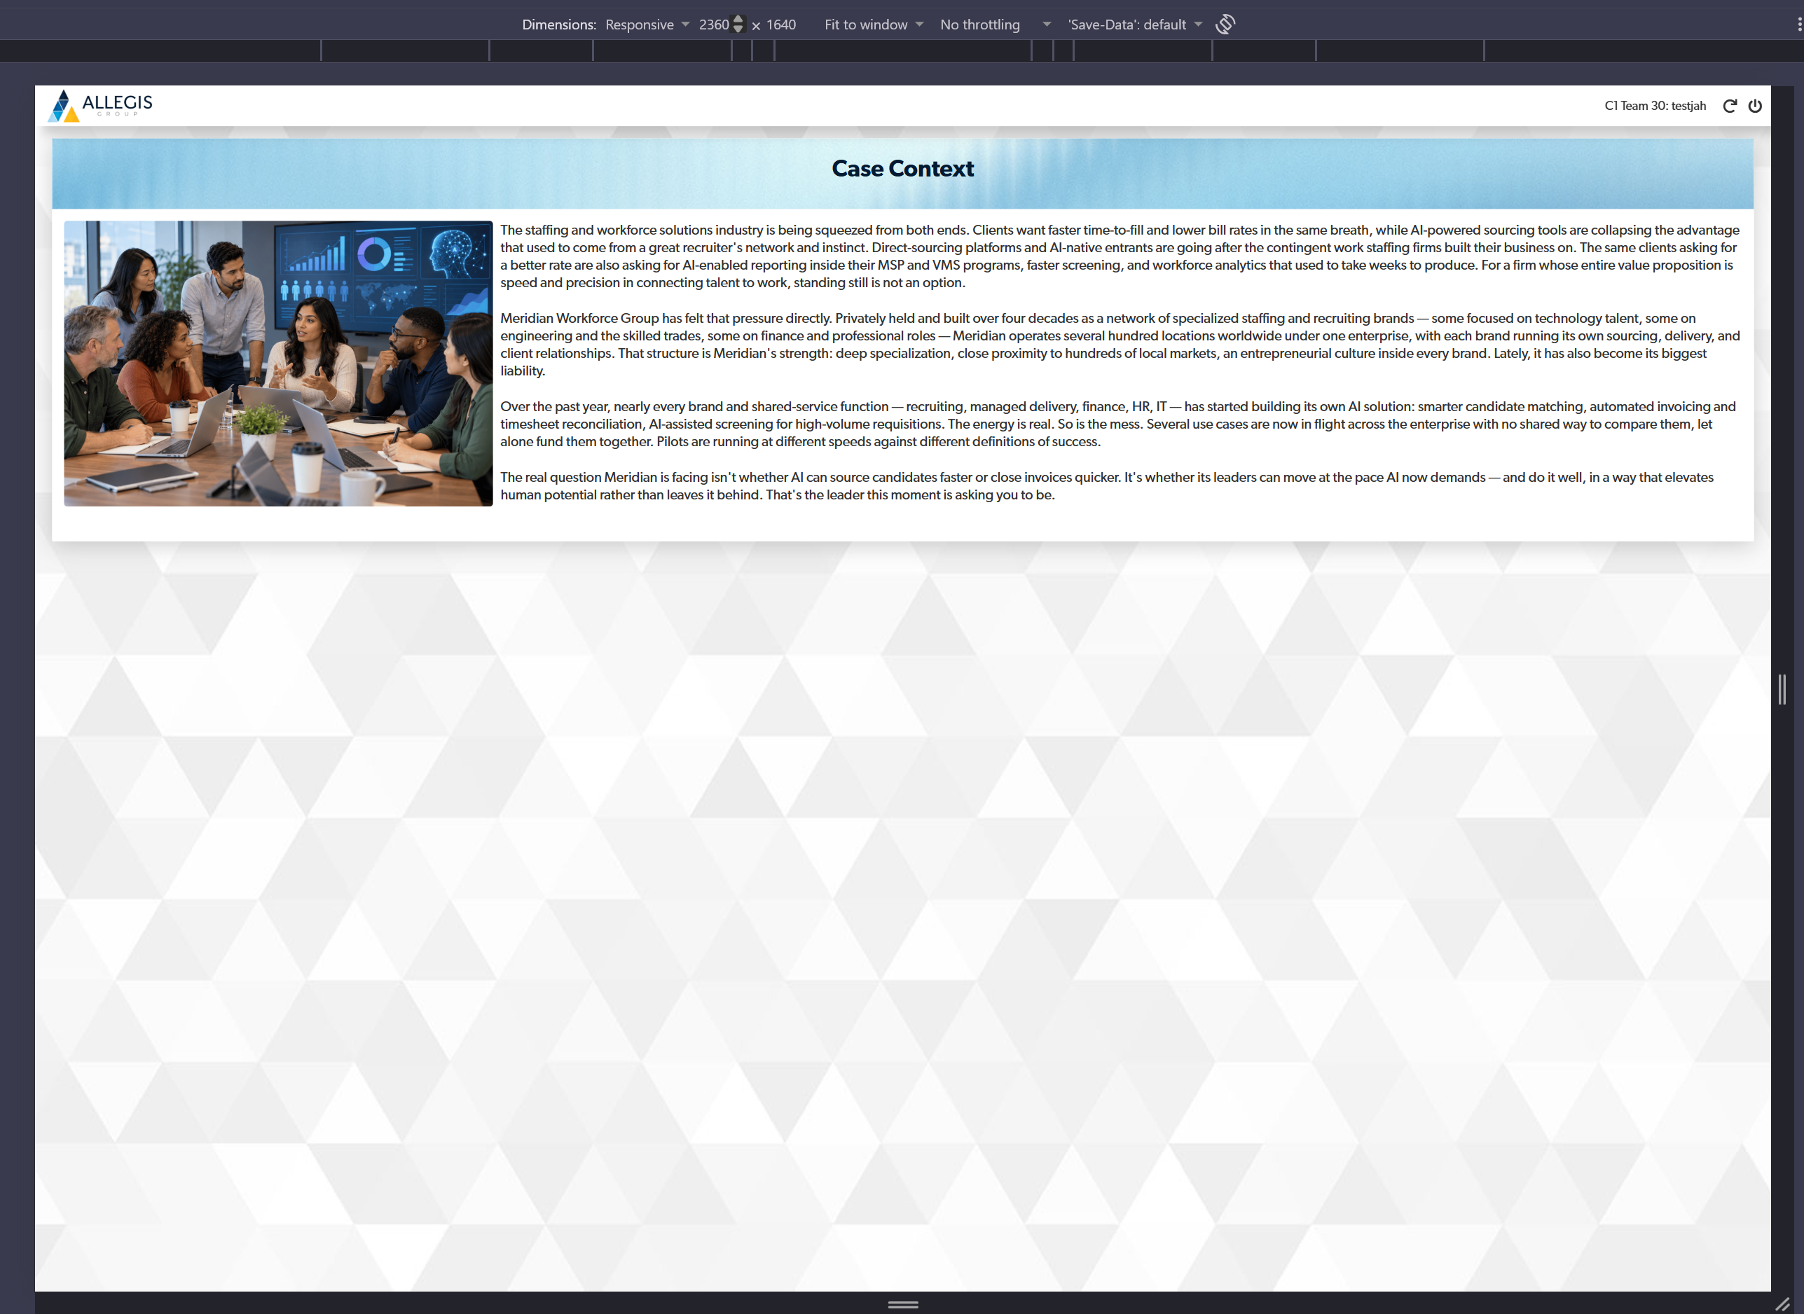
Change “Case Context” to “Welcome to Meridian”
Digital (15-Oct): Done

Slide 3
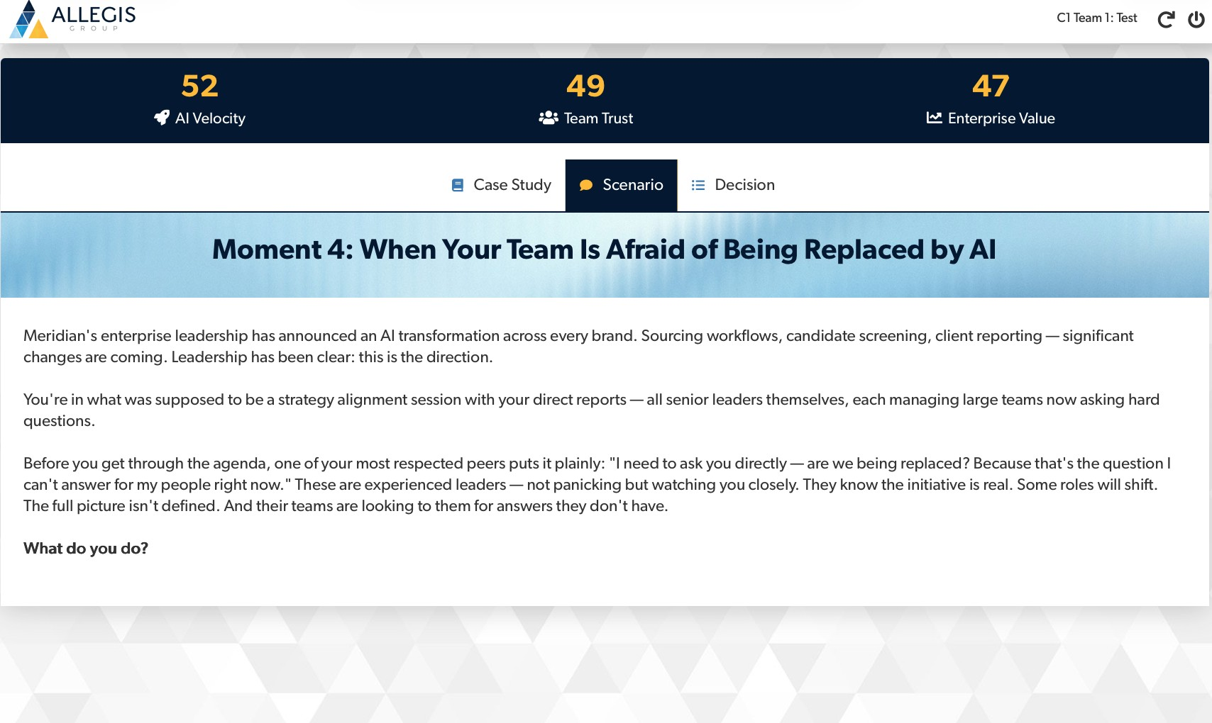
Remove em dashes from the case study and scenario text throughout the sim.
We can keep them in the options and feedback.
Digital (15-Oct): Em dashes removed from case study and scenario copy (replaced with appropriate punctuation); retained in options and feedback.

Slide 4
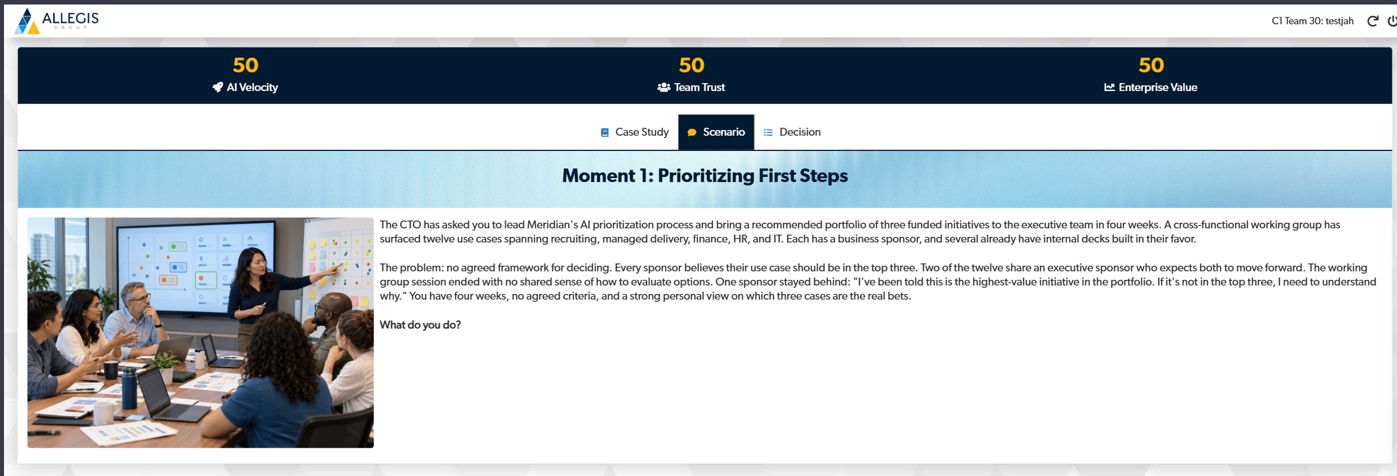
Update M1 text to the following:
Digital (15-Oct): Done
The Chief Technology Officer has asked you to lead Meridian's AI prioritization process and bring a recommended portfolio of three funded initiatives to the executive team in four weeks. A cross-functional working group has surfaced twelve use cases spanning recruiting, managed delivery, finance, HR, and IT. Each has a business sponsor, and several already have internal decks built in their favor.
The problem: no agreed framework for deciding. Every sponsor believes their use case should be in the top three. Two of the twelve share an executive sponsor who expects both to move forward. The working group session ended with no shared sense of how to evaluate options. One sponsor stayed behind: "I've been told this is the highest-value initiative in the portfolio. If it's not in the top three, I need to understand why." You have four weeks, no agreed criteria, and a strong personal view on which three cases are the real bets.
What do you do?

Slide 5
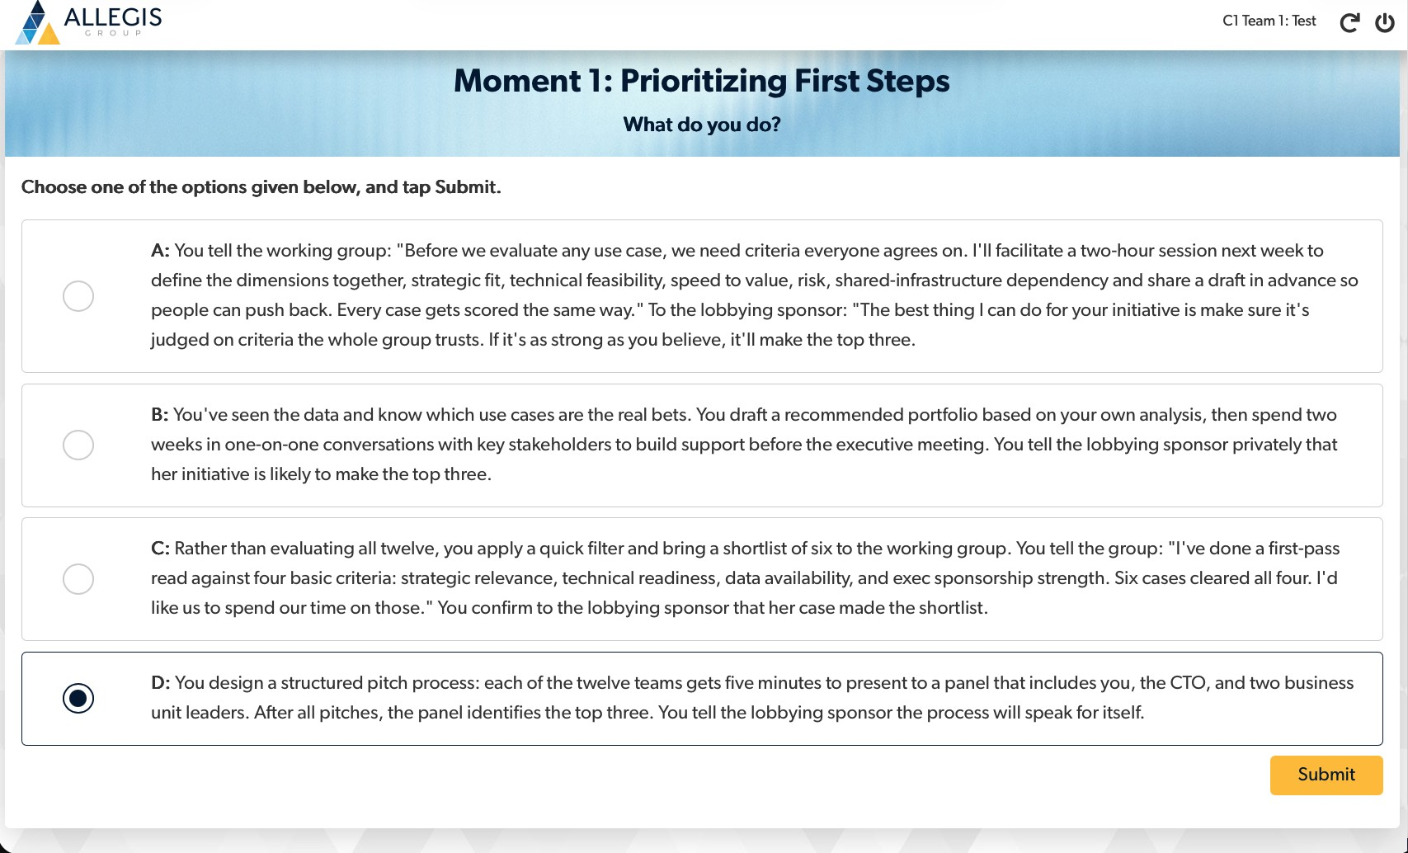
Update Moment 1 Option-D to the following text.
Digital (15-Oct): Done
You design a structured pitch process: each of the twelve teams gets five minutes to present to the same panel, made up of you, the CTO, and two business unit leaders, and each pitch is scored against the agreed criteria. After all twelve pitches, the panel identifies the top three. You tell the lobbying sponsor the process will speak for itself: if the initiative is as strong as they believe, it will earn its place.
Notes:
I know you were already planning to simplify the options. This is just the written note.

Slide 6
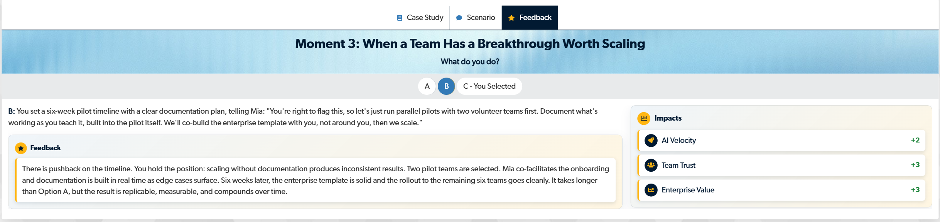
Update M3 Option-B feedback text to the following
There is pushback on the timeline, but you hold the position: scaling without documentation fragments the knowledge that made the breakthrough possible and produces inconsistent results across teams. Two pilot teams are selected. Mia co-facilitates the onboarding, and documentation is built in real time as edge cases surface. Six weeks later, the enterprise template is solid and the rollout to the remaining six teams goes cleanly. It takes longer up front, but the result is replicable, measurable, and compounds over time.
Digital (15-Oct): Done

Slide 7
Tested with iPad resolution – is this the right view?
JAH
Digital (15-Oct):
I’ve tested Chrome Developer Tools with the iPad Air resolution setting. Text and graphic sizes are too small.

Slide 8
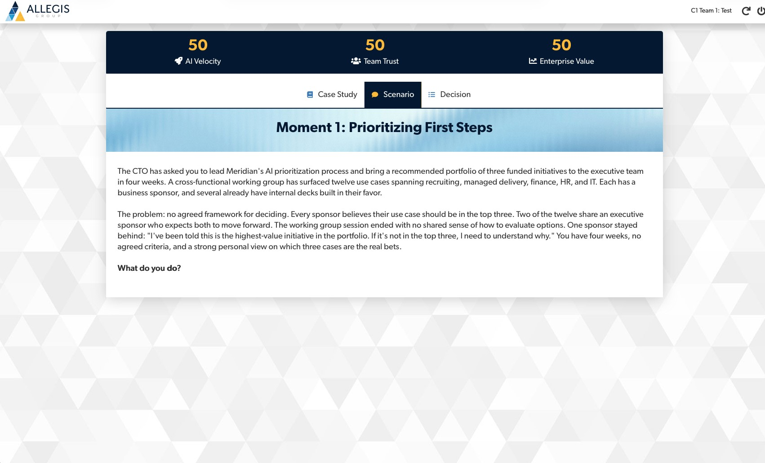
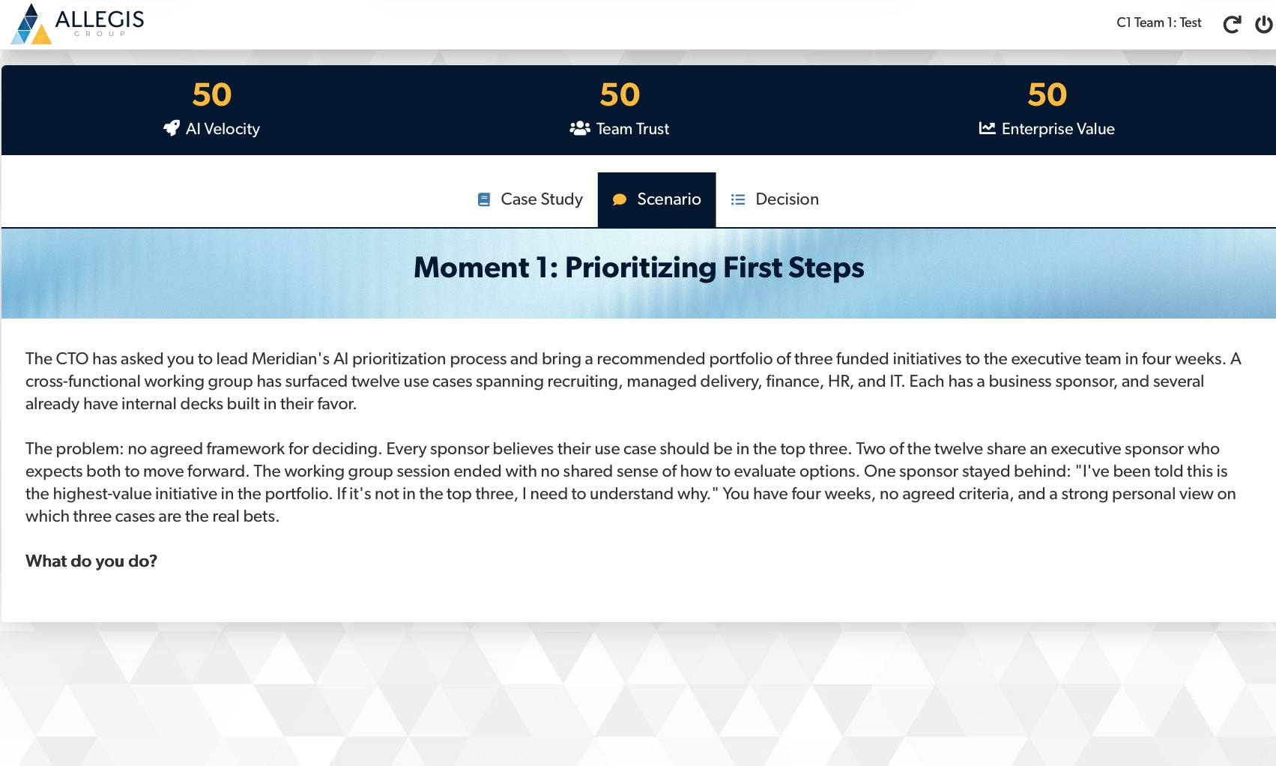
Make everything bigger
1
Digital (13-Oct): Done
Now
Zoomed in (use this as the new default)
Increase the size of everything: the logo, team name, buttons, and all text.
Notes:
Both screenshots show the same page. The second was taken with browser zoom increased. All later screenshots use the zoomed size.

Slide 9

Team name page: much, much bigger
2
Digital (13-Oct): Done
The text is tiny.
Enlarge the heading, the name field, the character counter, and the button.

Slide 10
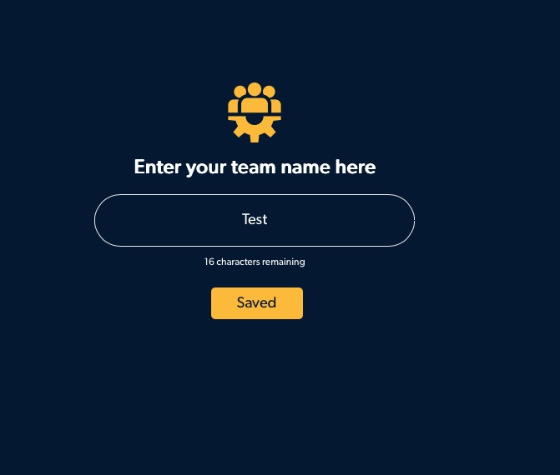
After submit: add a thank-you message
Digital (13-Oct): Done
3
Thank you!
Sit tight. Your facilitator will move everyone forward once all teams have submitted their names.
Suggested wording shown in the pop-up. Show it right after the team name is saved.

Slide 11
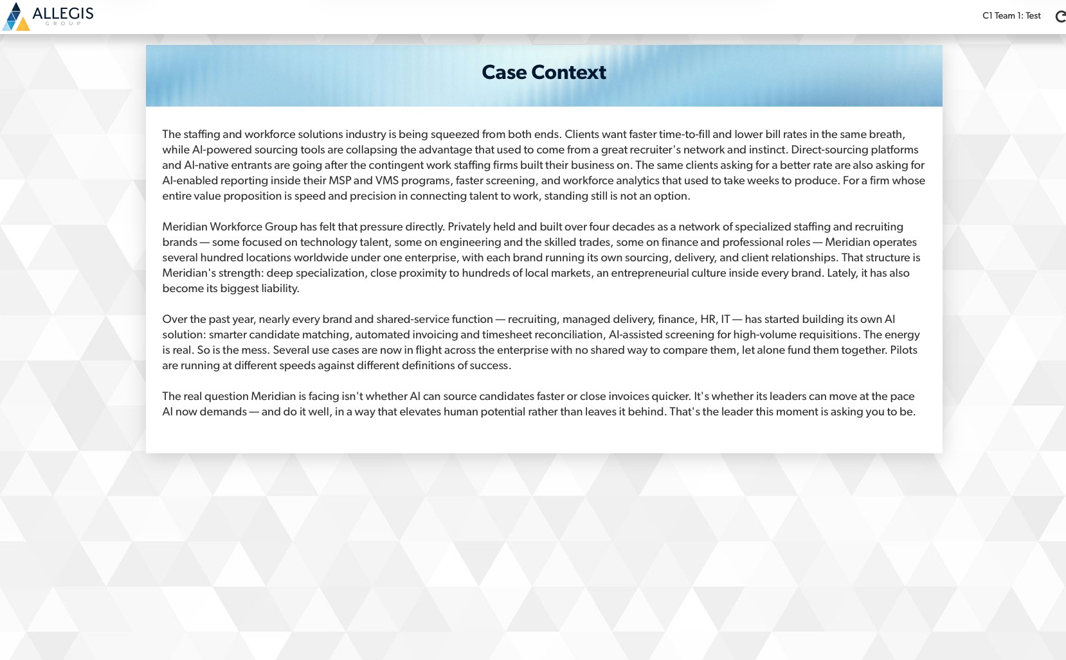


Case study: break up the wall of text
Digital (13-Oct): Done
4
Add an image here
A varied group of men and women working together in an office with greenery
Break up the text with an image. Show a mix of men and women so the group feels diverse. See examples for inspiration.
Notes:
The generated image is shared in chat. Drop it into the placeholder on the right. The first two images we saw only showed women, so this one should mix men and women.

Slide 12
Moment scenarios: add an image to each
Digital (13-Oct): Done
5
Every Moment scenario needs an image.
Remove the title after the : just keep Moment 1, 2, 3, etc.
Moments 1 to 4, plus the new information page.

Slide 13




Example ideas for moment images
Digital (13-Oct): Done

Slide 14

Submit and Saved buttons: change color
Digital (13-Oct): Done
6
Now
After a click (example)
Saved
Change the color once it is clicked, so teams can see it worked. Example: yellow, then green.
Notes:
The Saved button already reads Saved before anything is saved on the team name page. A color change would help, and the label may need to change too.

Slide 15
Add the split-screen look elsewhere
9
Digital (13-Oct): Please suggest which screen would you like us to update.
We could not find/identify any screen on the facilitator side where this split-screen photo style can be applied.
We love this
Use the split-screen photo style on the facilitator screens for a bit of visual variety.

Slide 16
DEV TEAM
DIGITAL TEAM CAN IGNORE
Notes:
Feedback on the digital sim build. Every screenshot after slide 2 was taken at the zoomed size.

Slide 17
For Kevin: equalize the Moment text
7
Kevin, as you review text (you mentioned simplifying) aim to equalize the length. Option A runs 4 lines. Option D runs 2. Simplify each one.
SEE FOLLOWING SLIDE
Notes:
I know you were already planning to simplify the options. This is just the written note.

Slide 18
Add CTO (Chief Technology? Talent? Officer)
JAH
- Add full description of abbreviations
- Will they have some understanding of “who” you’re supposed to be?

Slide 19
In the feedback – “it takes longer than Option A”.. Let’s add the essence of Option A, so they don’t have to go back to Option A and check
JAH

Slide 20
Remove em dashes throughout
8
Remove every em dash.
They show up in the case study, scenarios, options, and feedback text.
Kevin agrees, but lets remove them from the case only, we can keep them in the options.

Slide 21
Should the title of this page be something else? “Case Context” sounds a bit awkward
JAH
New Title:
Welcome to Meridian

Slide 22
New Text for Moment 1
7
Instead of making them shorter, I am going to expand option D on moment 1:
New Text for D:
You design a structured pitch process: each of the twelve teams gets five minutes to present to the same panel, made up of you, the CTO, and two business unit leaders, and each pitch is scored against the agreed criteria. After all twelve pitches, the panel identifies the top three. You tell the lobbying sponsor the process will speak for itself: if the initiative is as strong as they believe, it will earn its place.
Notes:
I know you were already planning to simplify the options. This is just the written note.

Slide 23
Remove em dashes throughout
8
Remove every em dash.
They show up in the case study, scenarios, options, and feedback text.
Kevin agrees, but lets remove them from the case only, we can keep them in the options.

Slide 24
Add CTO (Chief Technology? Talent? Officer)
JAH
New Text for Moment 1:
The Chief Technology Officer has asked you to lead Meridian's AI prioritization process and bring a recommended portfolio of three funded initiatives to the executive team in four weeks. A cross-functional working group has surfaced twelve use cases spanning recruiting, managed delivery, finance, HR, and IT. Each has a business sponsor, and several already have internal decks built in their favor.
The problem: no agreed framework for deciding. Every sponsor believes their use case should be in the top three. Two of the twelve share an executive sponsor who expects both to move forward. The working group session ended with no shared sense of how to evaluate options. One sponsor stayed behind: "I've been told this is the highest-value initiative in the portfolio. If it's not in the top three, I need to understand why." You have four weeks, no agreed criteria, and a strong personal view on which three cases are the real bets.
What do you do?

Slide 25
New Text for Option B Outcome:
There is pushback on the timeline, but you hold the position: scaling without documentation fragments the knowledge that made the breakthrough possible and produces inconsistent results across teams. Two pilot teams are selected. Mia co-facilitates the onboarding, and documentation is built in real time as edge cases surface. Six weeks later, the enterprise template is solid and the rollout to the remaining six teams goes cleanly. It takes longer up front, but the result is replicable, measurable, and compounds over time.
JAH

